Slide 1
Impact Of Car Features
Final Project-3
Project By: Sumit Gope

Slide 2
Project Description
The purpose of this project is to help a car manufacturer optimize pricing and product development decisions to maximize profitability while meeting consumer demand. This will be done by analyzing a dataset containing information on various car models and their specifications.
The business problem- The project aims to address is how a car manufacturer can effectively balance consumer demand and profitability when making pricing and product development decisions.
The data used in this project is the "Car Features and MSRP" dataset available on Kaggle, which contains information on over 11,000 car models and their specifications.
Data preprocessing: Cleaning and handling missing data.

Slide 3
Approach
The analytical methods used in this project include visualization, and machine learning techniques such as regression analysis and market segmentation.
Regression models were developed to predict car prices based on their features and market category. Market segmentation was used to identify consumer groups with similar preferences and buying behaviors.
One limitation of this project is that the dataset was last updated in 2017, so it may not reflect current trends or prices in the automotive industry.

Slide 4
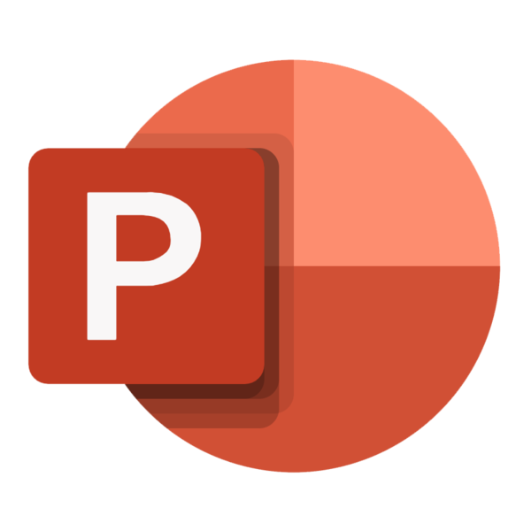

Tech-Stack Used
So I used Excel 2010 to gain insights from the dataset and for Data visualization.
After that I used PowerPoint for presentation of the project.

Slide 5
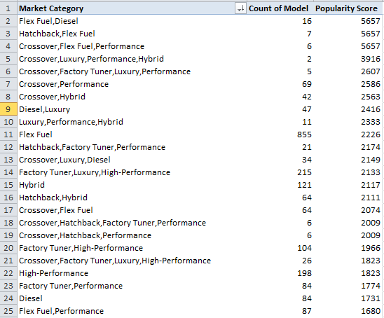
Insights
Insight Required: How does the popularity of a car model vary across different market categories?
Task 1.A: Create a pivot table that shows the number of car models in each market category and their corresponding popularity scores.
Solution- for this basically selected
pivot table and then
drag market category
column into row label
and drag model and
popularity score column
into values field. And
then Calculated the count
of model column and
average of popularity
column.

Slide 6
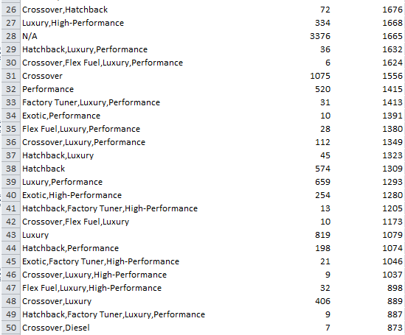

Slide 7
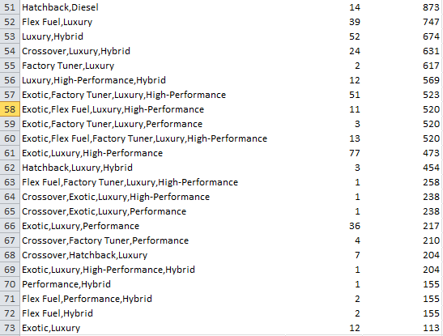

Slide 8

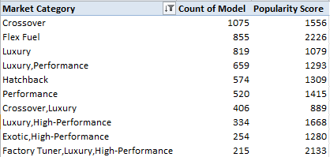
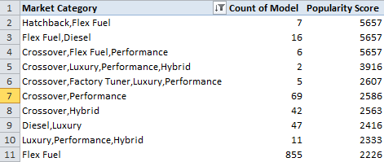
From the above output we can see that market category “crossover” have highest number of car models and popularity score is also decent. It means in this category competition is high.
If we talk about highest Popularity score hatchback,flex fuel have that spot on the top also having same score in ‘flex fuel,diesel’ and ‘crossover,flex,fuel,performance’ .
Apart from this market category ‘crossover,luxury’ having good number of models but low popularity score. Needs some improvement in this category.
Market category ‘crossover,luxury,performance,hybrid’ is in top 4 in popularity score but have only 2 number of model. Which means companies should increase the number of models in this category.

Slide 9
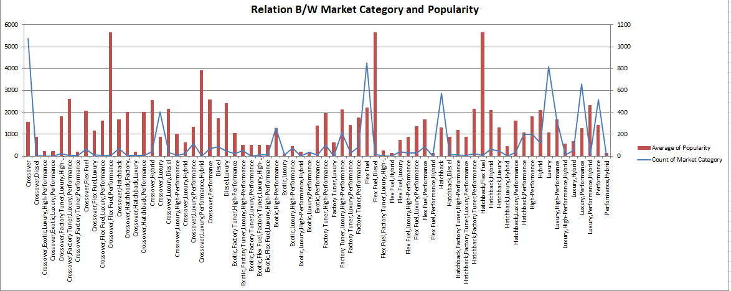
Task 1.B: Create a combo chart that visualizes the relationship between market category and popularity.
Solution- for this we simply use combo chart form the chart option.

Slide 10
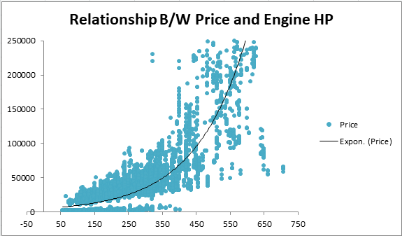
Insight Required: What is the relationship between a car's engine power and its price?
Task 2: Create a scatter chart that plots engine power on the x-axis and price on the y-axis. Add a trendline to the chart to visualize the relationship between these variables.
As we can see this the positive correlation we get from the Car price and Engine HP. It means increases in Engine horse power increases Cars Price.

Slide 11
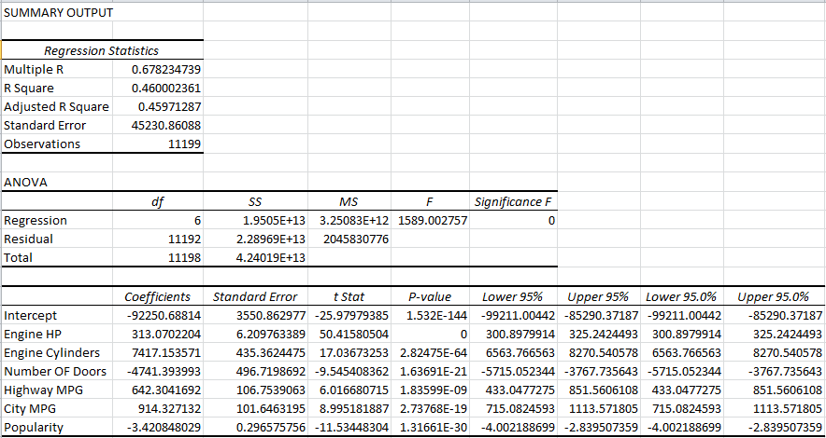
Insight Required: Which car features are most important in determining a car's price?
Task 3: Use regression analysis to identify the variables that have the strongest relationship with a car's price. Then create a bar chart that shows the coefficient values for each variable to visualize their relative importance.
Solution: for this I select the all numeric feature of cars and click on data analysis field from data section and then click on regression.

Slide 12

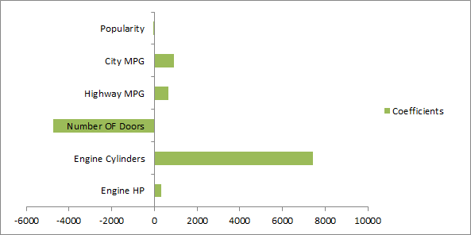
The coefficient for number of cylinders is positive, indicating that there is a strong positive relationship between the number of cylinders in a car's engine and its price. This suggests that cars with more cylinders tend to be more expensive.
The coefficient for number of doors is negative, indicating that there is a strong negative relationship between the number of doors a car has and its price. This suggests that cars with fewer doors tend to be more expensive.

Slide 13
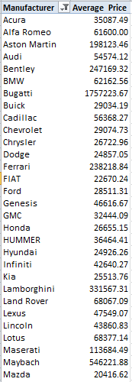
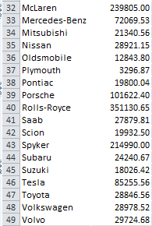
Insight Required: How does the average price of a car vary across different manufacturers?
Task 4.A: Create a pivot table that shows the average price of cars for each manufacturer.
Highest
Lowest
From this table we can see the average highest price of manufacturer is 1.7M$ which is Bugatti and average lowest price of manufacturer is 3296$ which is plymouth.

Slide 14
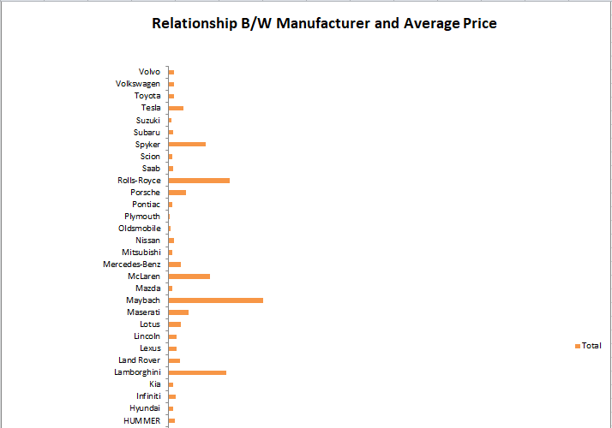
Task 4.B: Create a bar chart or a horizontal stacked bar chart that visualizes the relationship between manufacturer and average price.

Slide 15
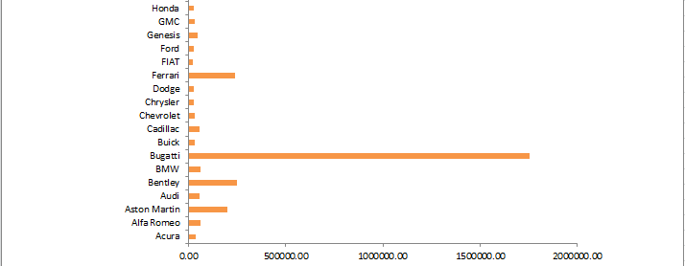

Plymouth is a brand that is associated with more affordable or budget-friendly cars, while Bugatti is a luxury brand that produces high-end, expensive vehicles. This suggests that car prices can vary widely across different manufacturers, depending on the brand's positioning in the market.
The range between the lowest and highest average prices is quite large, indicating that car prices can vary significantly even within the same market segment. This can be due to a variety of factors such as differences in manufacturing costs, brand reputation, features, and technology.

Slide 16
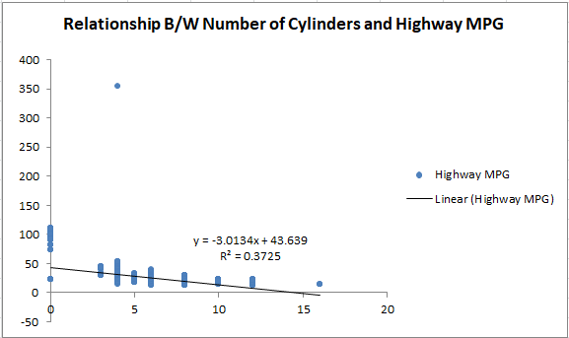
Insight Required: What is the relationship between fuel efficiency and the number of cylinders in a car's engine?
Task 5.A: Create a scatter plot with the number of cylinders on the x-axis and highway MPG on the y-axis. Then create a trendline on the scatter plot to visually estimate the slope of the relationship and assess its significance.

Slide 17


The slope of the linear equation is negative, which indicates an inverse relationship between the x and y variables. In other words, as the value of x increases, the value of y decreases, and vice versa.
The magnitude of the slope (-3.0134) indicates the strength of the relationship between the two variables. A larger magnitude suggests a stronger relationship between the variables.
Task 5.B: Calculate the correlation coefficient between the number of cylinders and highway MPG to quantify the strength and direction of the relationship.
A correlation coefficient value of -0.61033 indicates a moderate negative correlation between the number of cylinders and highway MPG. This means that as the number of cylinders in a car's engine increases, its highway MPG generally decreases, and vice versa.
The absolute value of -0.61033 is closer to 1 than to 0, indicating a moderate strength of correlation between the two variables. Therefore, we can conclude that there is a significant relationship between the number of cylinders and highway MPG.

Slide 18
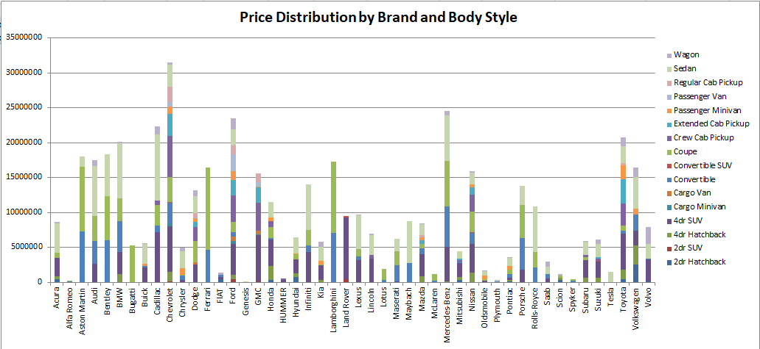
Dashboard Tasks
Task 1: How does the distribution of car prices vary by brand and body style?

Slide 19

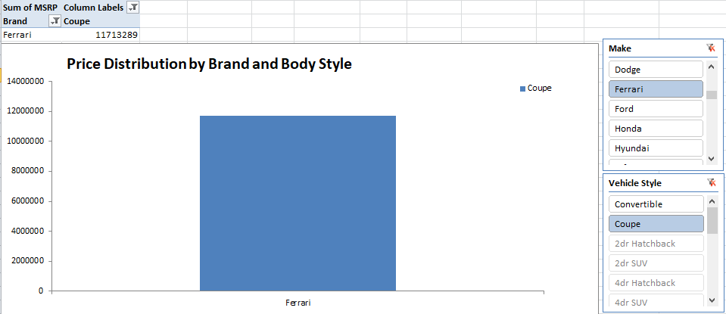
The fact that the brand Ferrari with the body style coupe has the highest price and the brand Mitsubishi with the body styles cargo minivan and passenger minivan has the lowest price indicates that there is a wide range of prices across different brands and body styles.

Slide 20
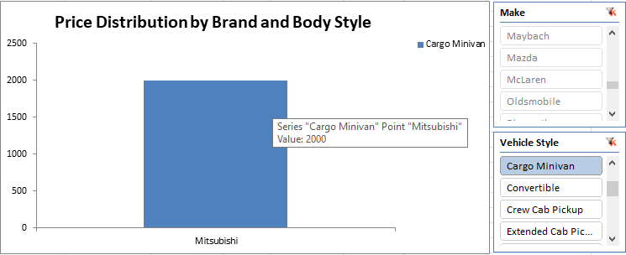
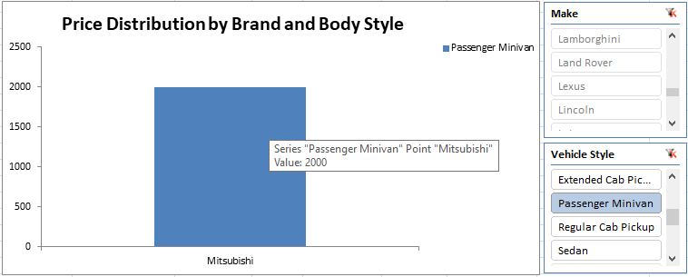

Slide 21
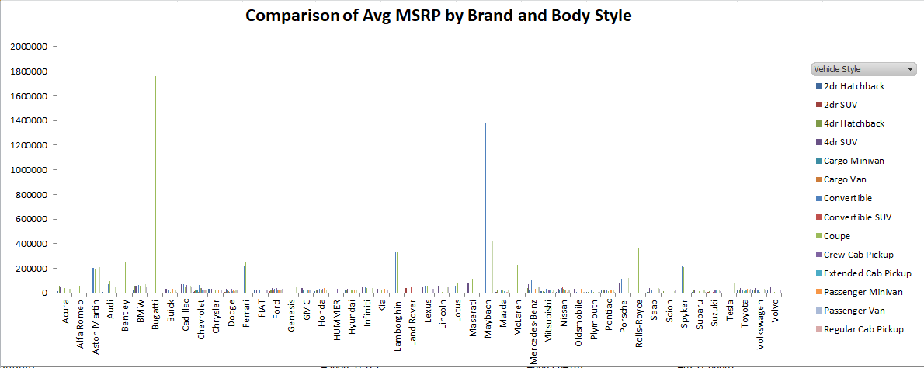
Task 2: Which car brands have the highest and lowest average MSRPs, and how does this vary by body style?

Slide 22

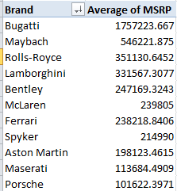
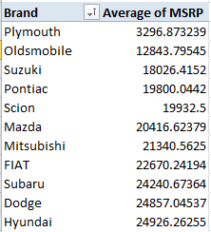
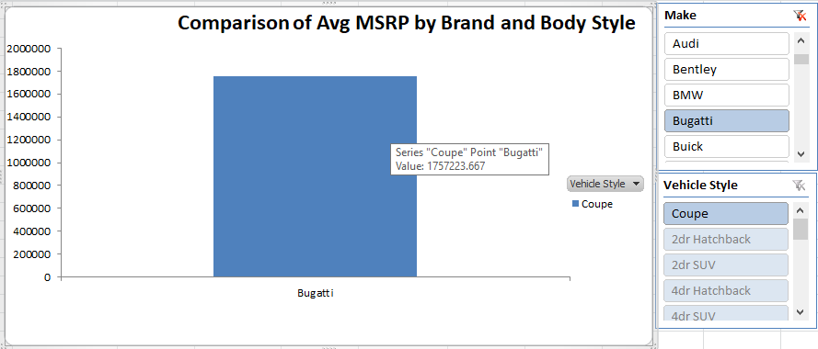
Highest MSRP
Lowest MSRP
So the Bugatti have highest average MSRP which has only one body style which is Coupe.

Slide 23
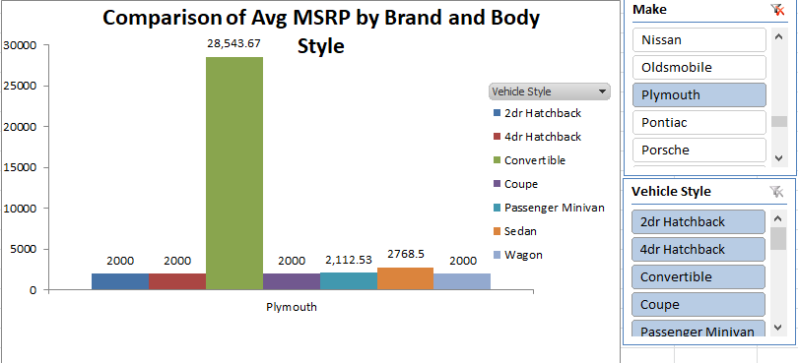
So the Plymouth have Lowest average MSRP which has 7 body style which are 2dr hatchback, 4dr hatchback, convertible, coupe, passenger minivan, sedan and wagon.

Slide 24
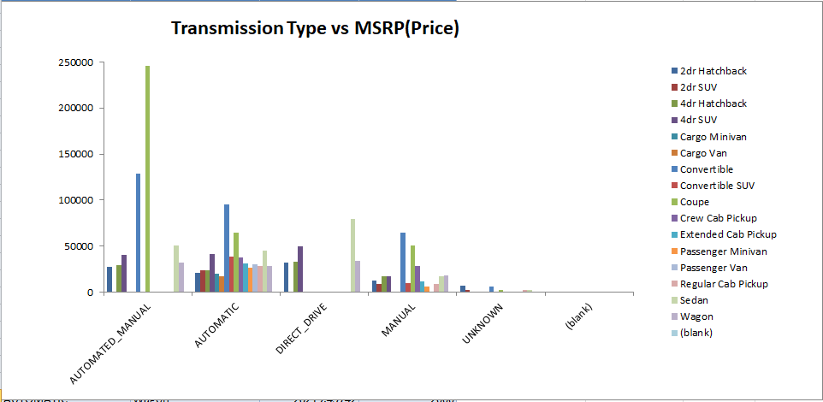
Task 3: How do the different feature such as transmission type affect the MSRP, and how does this vary by body style?

Slide 25

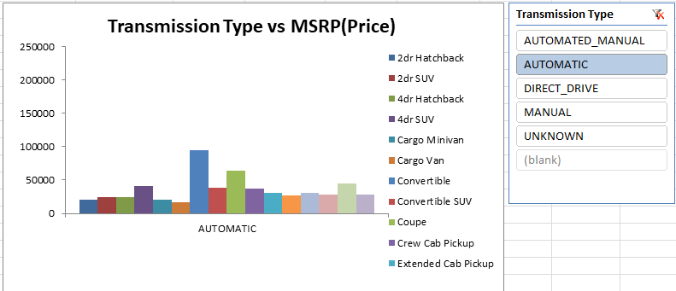
The data shows that on average, cars with automatic transmission have a higher MSRP compared to cars with manual transmission.

Slide 26

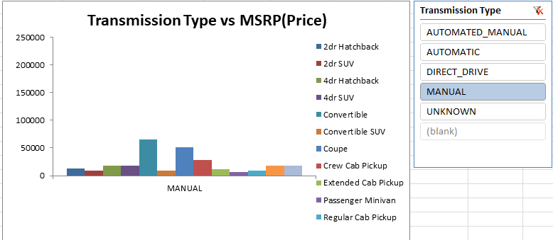
The price difference between automatic and manual transmission cars varies across body styles. For example, the price difference is larger for cargo van and minivan compared to Convertible and coupes.

Slide 27
The combination of body style and transmission type has a notable impact on the MSRP. Body styles associated with higher price points, such as convertibles and coupes, tend to command a premium when equipped with automated manual transmissions.
On the other hand, body styles like 2-door hatchbacks and SUVs generally have lower average prices, appealing to cost-conscious consumers.
The 4-door hatchback, sedan, and wagon fall in the mid-range, offering a balance between price, functionality, and performance.

Slide 28
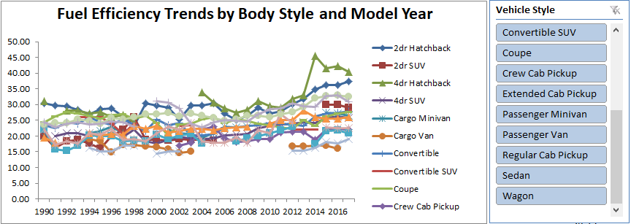
Task 4: How does the fuel efficiency of cars vary across different body styles and model years?

Slide 29
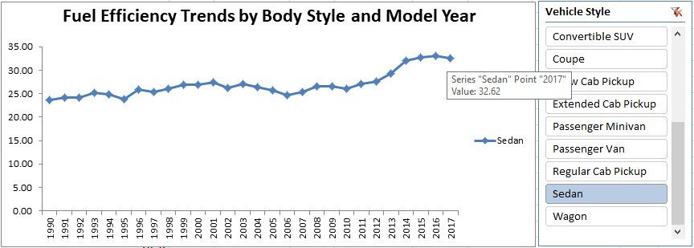
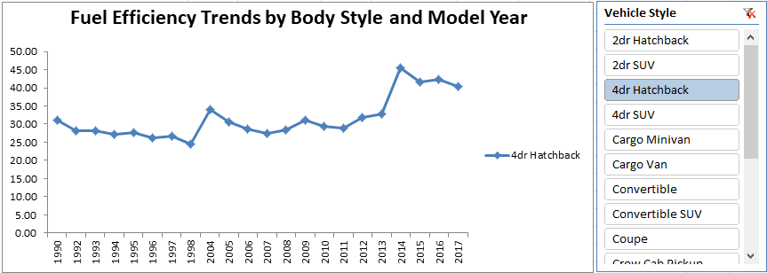

Slide 30
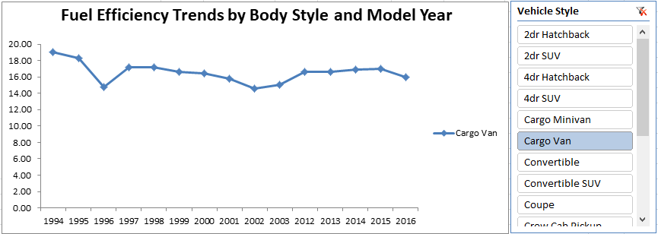
One key insight is that Sedan and 4dr Hatchback body styles have significantly improved their fuel efficiency over time. The line chart shows a clear upward trend in fuel efficiency for both body styles across different model years.
The fuel efficiency of Cargo van has actually decreased slightly over time. The line chart shows a slight downward trend in fuel efficiency for cargo vans across different model years, with the average fuel efficiency dropping from 19 mpg to 16 mpg. This trend may be concerning for consumers who prioritize fuel efficiency.

Slide 31
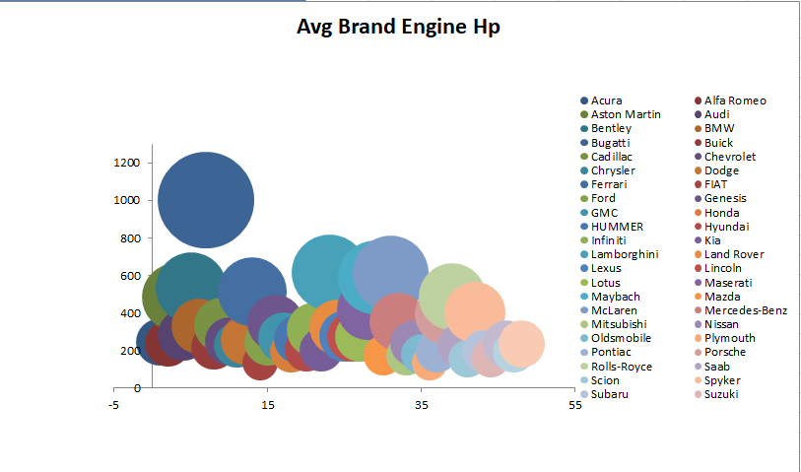
Task 5: How does the car's horsepower, MPG, and price vary across different Brands?

Slide 32
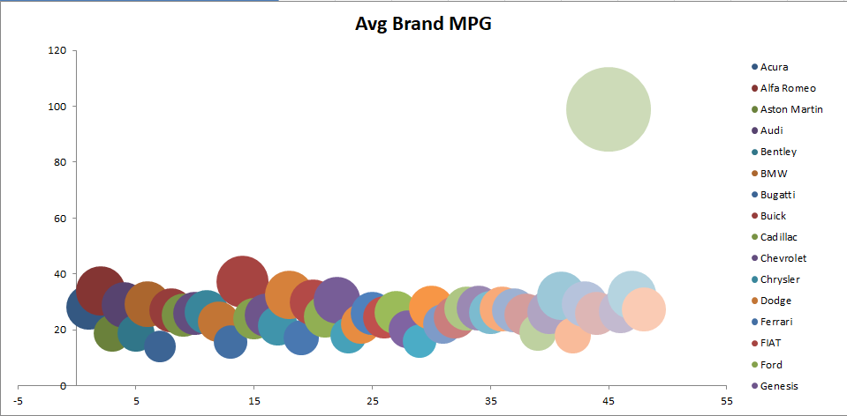

Slide 33
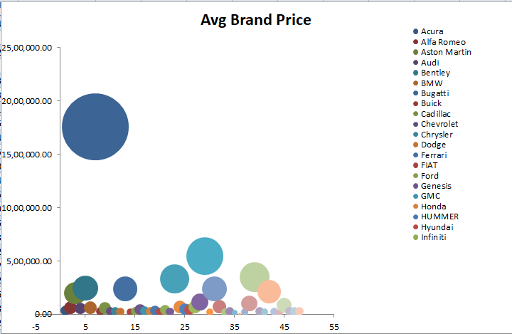

Slide 34

Result
Based on the data analysis, the following recommendations can be made to enhance the business:
Market Category Enhancement:
Companies should focus on the "crossover" category, which has the highest number of car models but also high competition. They should strive to differentiate their offerings and provide unique features or value propositions to stand out in this crowded market.

Slide 35

Improving Crossover Luxury Category
The market category "crossover, luxury" has a good number of models but a low popularity score. To improve their business in this category, companies should invest in enhancing the luxury features and overall appeal of their crossover models. This could involve incorporating premium materials, advanced technology, and superior performance to attract luxury car buyers.

Slide 36

Expanding Models in Performance Hybrid Category
Although the market category "crossover, luxury, performance, hybrid" ranks high in terms of popularity score, it has a limited number of models. Companies should consider expanding their offerings in this category to capitalize on the growing demand for high-performance hybrid vehicles. By providing more choices, they can attract customers seeking both luxury and environmentally friendly options.

Slide 37
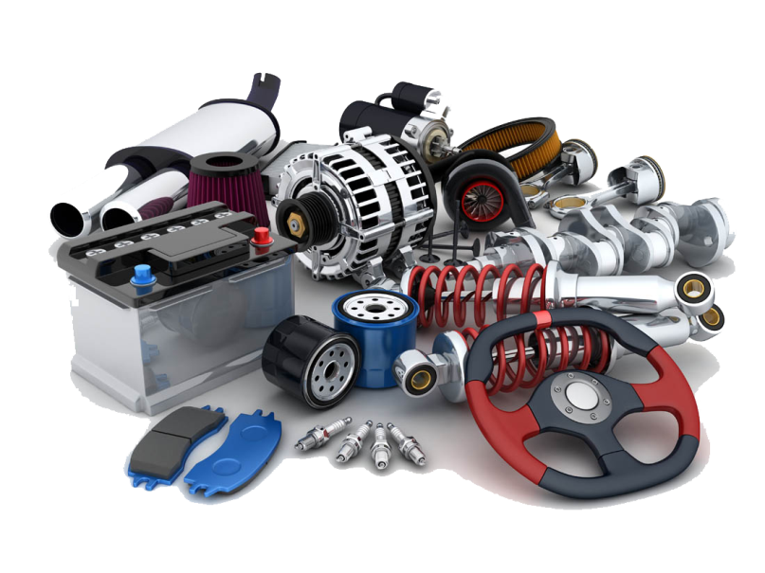
Leveraging Engine Horsepower for Pricing
The positive correlation between car price and engine horsepower suggests that companies can position their higher-priced models as performance-oriented vehicles. By investing in engine development and showcasing the power and performance capabilities of their cars, companies can justify premium pricing and target customers who prioritize performance.

Slide 38

Strategic Brand Positioning
Analyzing the variation in average prices across different manufacturers and body styles, it is essential for companies to strategically position their brands. For affordable or budget-friendly brands like Plymouth, emphasizing value for money and practicality can attract price-conscious consumers. Luxury brands like Bugatti should focus on exclusivity, craftsmanship, and cutting-edge technology to justify their premium prices.

Slide 39

Optimizing Transmission Options
Companies should consider the impact of transmission types on prices. Automatic transmissions generally command higher prices, so it is important to offer a range of transmission options that align with customer preferences and budget constraints. Additionally, for body styles where the price difference between transmission types is significant (such as cargo vans and minivans), providing both options can cater to a broader customer base.

Slide 40

Continuous Improvement in Fuel Efficiency:
While Sedan and 4-door Hatchback body styles have shown improved fuel efficiency over time, companies should prioritize innovation in fuel-efficient technologies across all body styles. This can include developing hybrid or electric variants, optimizing engine performance, and reducing overall vehicle weight to appeal to environmentally conscious consumers.

Slide 41
Project Workbook Link:
https://docs.google.com/spreadsheets/d/1po0oY6qg_Bp0J8cbpeGpB0Rk8QciryNr/edit?usp=share_link&ouid=112692218028277537705&rtpof=true&sd=true

Slide 42


